Slide 1
ENGR 4020
Lab 1 Slides
Adapted from work by Matthew Stein

Slide 2
Getting Started with the MBED
ide.mbed.com/compiler

Slide 3
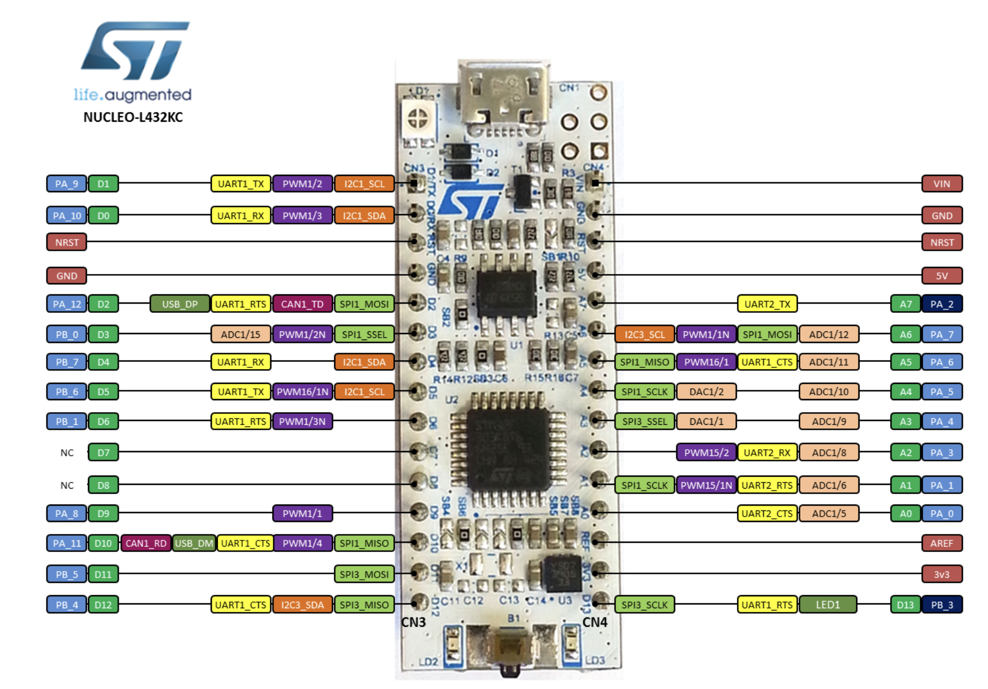

Slide 4
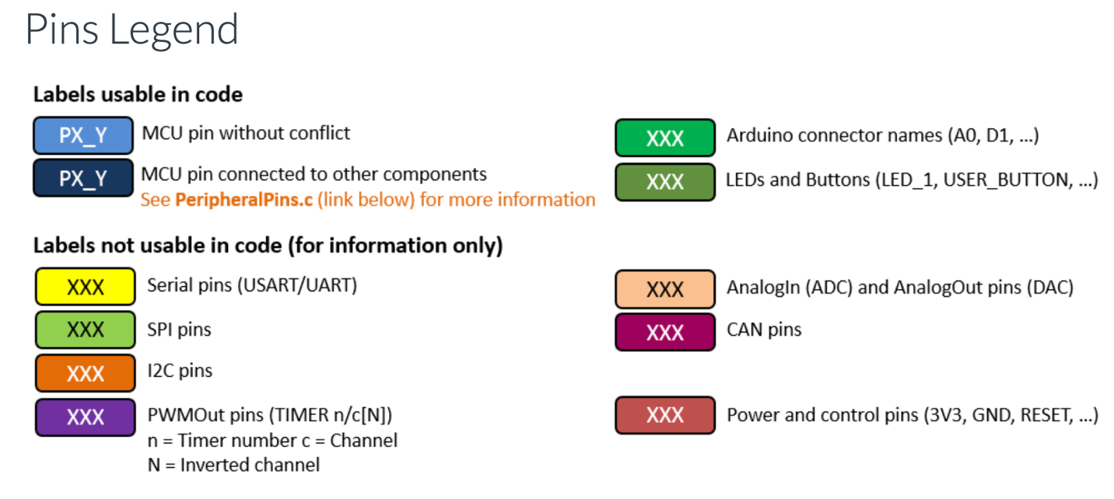

Slide 5

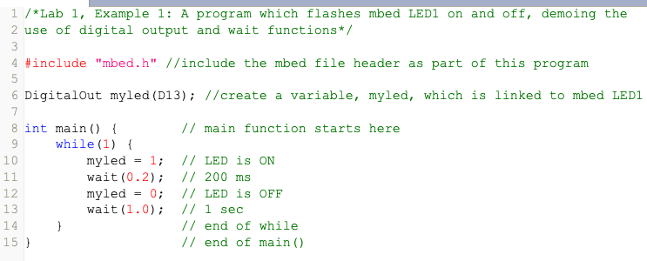

My First Program (c++)

Slide 6
Programming Tips
Commenting is required
//one line
/* multi line */
Semicolons
Required to end command lines, not required when line ends in open bracket (or parentheses)
Wait functions
wait (seconds) [float]
wait_ms (milliseconds) [int]
wait_us (microseconds) [int]

Slide 7
Programming Tips
#include: pulls library and header files into the program
Much more on this in future
Main code often happens in while loop (so that the program continues to repeat)
Variables must be declared in preamble before “main”
Type Name [optional initial value]

Slide 8
Digital Outputs
mbed API Digital Outputs
DigitalOut: create a digital output object connected to a specific pin
write: set the output to 0 or 1 (0 or 3v3)
read: return the output setting of the object
= is shorthand for ‘write’
int() is shorthand for read

Slide 9
Digital Output and Loop PRACTICE
Connect an LED to pin D2

Slide 10
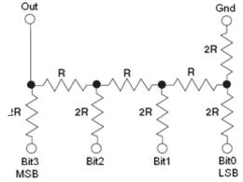
Easy D/A conversion
If each bit is a 3V3/0V signal
This circuit effectively adds bits together

Slide 11
Digital Range
4-Bit number
Range 0-15
Represents in volts 0 to VREF in increments of 1/15th
If VREF = +3V3
Every bit is 3.3/15 [V] or 0.22 [V]

Slide 12
Possible Representations
4-Bit number representing 0V – 3V3
Binary Number | Voltage |  | Binary Number | Voltage
0000 | 0V |  | 1000 | 1.76V
0001 | .22V |  | 1001 | 1.98V
0010 | .44V |  | 1010 | 2.2V
0011 | .66V |  | 1011 | 2.42V
0100 | .88V |  | 1100 | 2.64V
0101 | 1.1V |  | 1101 | 2.86V
0110 | 1.32V |  | 1110 | 3.08V
0111 | 1.54V |  | 1111 | 3.3V

Slide 13
Easy D/A conversion
If each bit is a 3V3/0V signal
This circuit effectively adds bits together

Slide 14
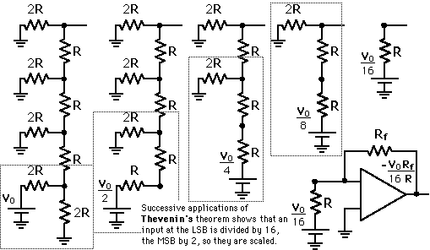
Easy conversion
Wikipedia Thevenin Example: R-2R Ladder

Slide 15
D/A Conversion
D/A works by a relatively straightforward resistor network.
4 bit nibble represents 16 distinct voltages scaled by VREF
More bits more distinct voltages
Conversion instantaneous (i.e speed of light)

Slide 16
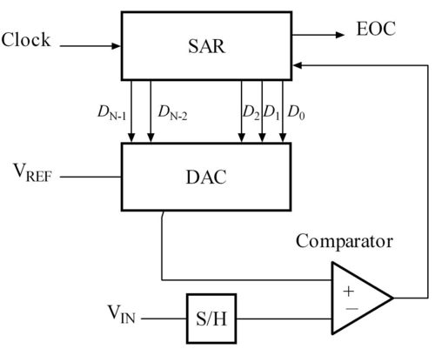
Simple A/D Conversion
Uses D/A and successive approximation.
Counter increases binary number until voltages match
Once matched,
signal the end of A/D
More complex schemes are faster but not that different

Slide 17
A/D Conversion
Result is a n-bit binary number representing voltage (percentage of VREF)
More bits more precision
8 bits = 256 distinct voltages
10 bits = 1024 voltages (2 ¹⁰ )

Slide 18
D/A Lab Exercise
Build this circuit
Any resistor > 1K will do
Get 13 identical resistors
Wire them up like this
Probe
Output ports D2-5

Slide 19
Lab Exercise
Write code which will output 4 bit numbers in succession (0-15) with D2 being the least significant bit, and D5 being most significant bit, connected to your ladder from previous slide
Wait 1 second between each increment
Read the data on the multimeter
At the end of today’s lab, you will submit your code (.cpp file and .bin file on Canvas). If it works, it’s 10 point
+2 points for the fewest lines of code
In addition, document this lab exercise in your lab notebook, including the printed out .cpp file

